Slide 1
ANOVA (one way ANOVA)
Dr. Srinibash Dash
Associate Professor & Head
School of Management
Gangadhar Meher University

Slide 2
Content
Introduction
Objective
Types of ANOVA
Assumption
Hypotheses
One way ANOVA test

Slide 3
Introduction to ANOVA
ANOVA was developed by Ronald Fisher in 1918.
ANOVA stands for analysis of variance. it’s a statistical method used to compare means across two or more groups to determine if there are statistically significant differences between them.
Purpose
The main purpose of ANOVA is to assess whether the means of different groups are equal or if there is at least one group that differs significantly from the others.

Slide 4
When to use ANOVA
ANOVA is typically used when you have more than two groups and want to compare their means simultaneously.
It's commonly employed in experimental research settings, such as comparing the effectiveness of different treatments, analyzing survey data with multiple response options, or studying the impact of different factors on a dependent variable.

Slide 5
Objective of ANOVA
Detecting Differences: ANOVA helps researchers determine whether there are statistically significant differences in means between groups. This is essential for understanding variations in data and identifying factors that may influence the dependent variable.
Comparing Group Means: ANOVA allows researchers to compare the means of multiple groups simultaneously, rather than conducting separate pairwise comparisons. This helps prevent inflated Type I error rates and provides a more comprehensive understanding of group differences.

Slide 6
Identifying Sources of Variation: ANOVA partitions the total variation in the data into different sources, such as variation between groups and variation within groups. By quantifying these sources of variation, researchers can identify which factors contribute most to differences in the dependent variable.
Making Inferences: ANOVA provides statistical evidence to support or refute hypotheses about group differences. This helps researchers draw conclusions about the effects of experimental treatments, interventions, or other factors on the outcome of interest.
Informing Decision Making: The results of ANOVA can inform decision-making processes in various fields, including scientific research, business, healthcare, and education. For example, ANOVA results may guide policy decisions, treatment strategies, or resource allocation based on identified group differences.

Slide 7
Types of ANOVA
One way ANOVA
Two way ANOVA
This is the most basic form of ANOVA and is used when there is one categorical independent variable with three or more levels(groups). It compares the means of these groups to determine if there are significant differences.
It is also known as factorial ANOVA, this type of ANOVA is used when there are two independent variables, both of which are categorical. It examines the main effects of each independent variable as well as their interaction effect on the dependent variable.

Slide 8
Assumption
Normality: The data within each group should follow a normal distribution. This means that when you plot the data for each group on a histogram or a Q-Q plot, the distribution should resemble a bell-shaped curve. While ANOVA is robust to violations of normality when sample sizes are large, it's still important to check this assumption, especially with smaller sample sizes.
Homogeneity of Variance: The variances of the groups being compared should be approximately equal. This means that the spread or dispersion of scores within each group should be similar across all groups. Violations of this assumption can lead to inaccurate results, particularly if the sample sizes are unequal.
Independence: Observations within each group should be independent of each other. This means that the data points within one group should not be influenced by or related to the data points in another group. For example, in a study comparing the effects of different teaching methods on student performance, each student's performance should be independent of the performance of other students.

Slide 9
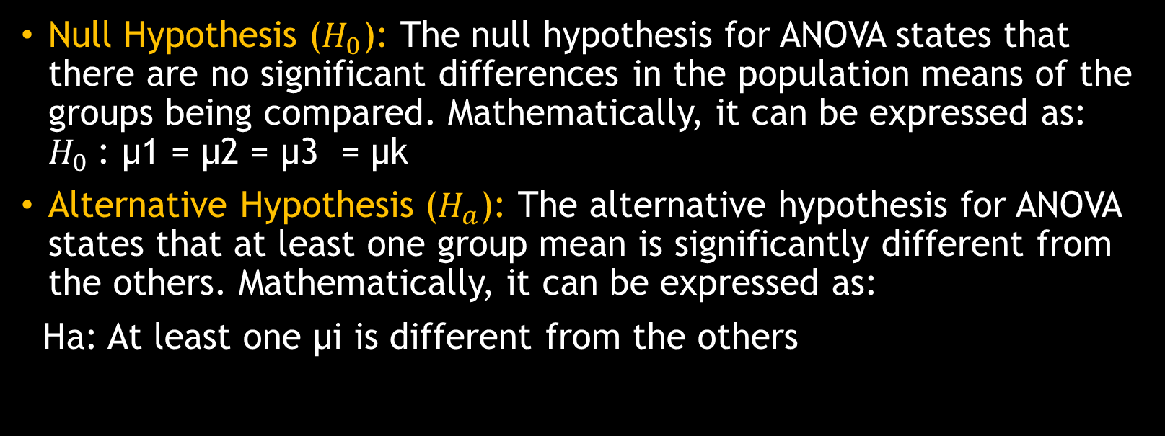
Hypotheses
Null Hypothesis ($H_{0}$): The null hypothesis for ANOVA states that there are no significant differences in the population means of the groups being compared. Mathematically, it can be expressed as: $H_{0}$: μ1 = μ2 = μ3 = µk
Alternative Hypothesis ($H_{a}$): The alternative hypothesis for ANOVA states that at least one group mean is significantly different from the others. Mathematically, it can be expressed as:
Ha: At least one μi is different from the others

Slide 10
One way ANOVA test
Q. To assess the significance of possible variation in performance in a certain test between the school of a city a common test watch given to a number of student taken of random from the 12th class of the three school concern the results given below;
Make the analysis of variance for the given data.
A | B | C
2 | 3 | 4
4 | 5 | 6
6 | 7 | 8

Slide 11
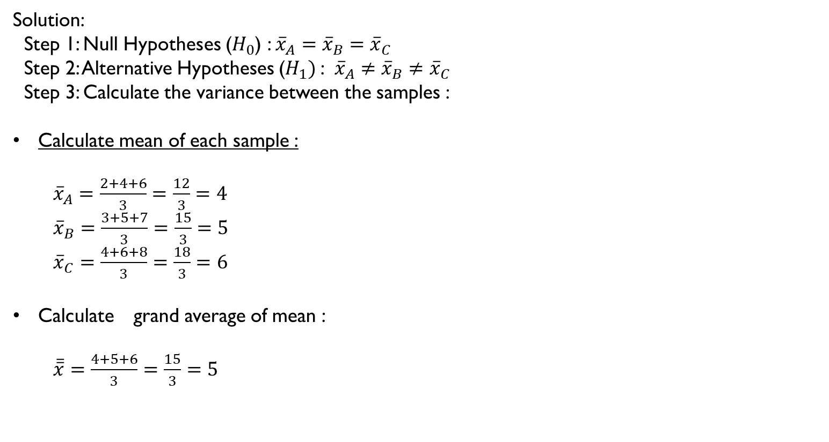
Solution:
Step 1: Null Hypotheses ($H_{0}$) : ${\overline{x}}_{A}={\overline{x}}_{B}={\overline{x}}_{C}$
Step 2: Alternative Hypotheses ($H_{1})$: ${\overline{x}}_{A}≠{\overline{x}}_{B}≠{\overline{x}}_{C}$
Step 3: Calculate the variance between the samples :
Calculate mean of each sample :
${\overline{x}}_{A}=\frac{2+4+6}{3}=\frac{12}{3}=4$
${\overline{x}}_{B}=\frac{3+5+7}{3}=\frac{15}{3}=5$
${\overline{x}}_{C}=\frac{4+6+8}{3}=\frac{18}{3}=6$
Calculate grand average of mean :
$\overline{\overline{x}}=\frac{4+5+6}{3}=\frac{15}{3}=5$

Slide 12
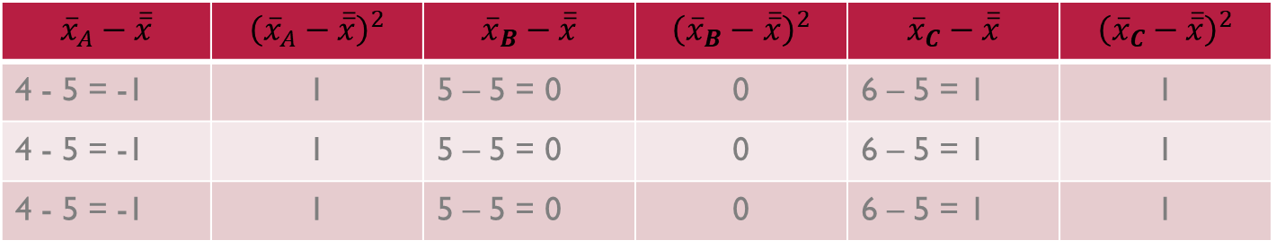

Calculation of SSC ( Sum of square between Sample )
$\sum{{\left({\overline{x}}_{A}−\overline{\overline{x}}\right)}^{2}}$=3 $\sum{{\left({\overline{x}}_{B}−\overline{\overline{x}}\right)}^{2}=0}$ $\sum{{\left({\overline{x}}_{C}−\overline{\overline{x}}\right)}^{2}=3}$
Hence, SSC = 3 + 0 + 3 = 6
$${\overline{x}}_{A}−\overline{\overline{x}}$$ | $${\left({\overline{x}}_{A}−\overline{\overline{x}}\right)}^{2}$$ | $${\overline{x}}_{B}−\overline{\overline{x}}$$ | $${\left({\overline{x}}_{B}−\overline{\overline{x}}\right)}^{2}$$ | $${\overline{x}}_{C}−\overline{\overline{x}}$$ | $${\left({\overline{x}}_{C}−\overline{\overline{x}}\right)}^{2}$$
4 - 5 = -1 | 1 | 5 – 5 = 0 | 0 | 6 – 5 = 1 | 1
4 - 5 = -1 | 1 | 5 – 5 = 0 | 0 | 6 – 5 = 1 | 1
4 - 5 = -1 | 1 | 5 – 5 = 0 | 0 | 6 – 5 = 1 | 1

Slide 13

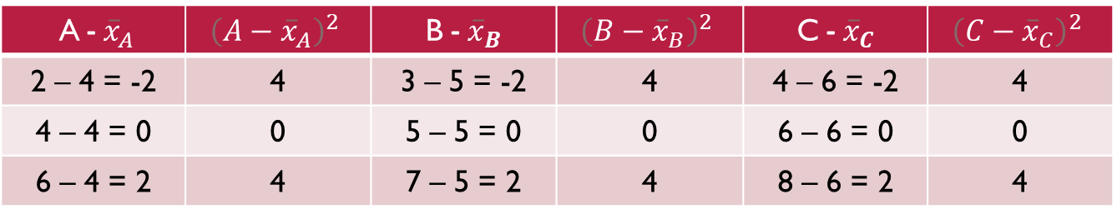
Calculation of SSE ( Sum of square within Sample )
$\sum{{\left(A−{\overline{x}}_{A}\right)}^{2}}$=8 $\sum{{\left({B−\overline{x}}_{B}\right)}^{2}=8}$ $\sum{{\left({C−\overline{x}}_{C}\right)}^{2}=8}$
Hence, SSE = 8 + 8 + 8 = 24
A - ${\overline{x}}_{A}$ | $${\left(A−{\overline{x}}_{A}\right)}^{2}$$ | B - ${\overline{x}}_{B}$ | $${\left(B−{\overline{x}}_{B}\right)}^{2}$$ | C - ${\overline{x}}_{C}$ | $${\left(C−{\overline{x}}_{C}\right)}^{2}$$
2 – 4 = -2 | 4 | 3 – 5 = -2 | 4 | 4 – 6 = -2 | 4
4 – 4 = 0 | 0 | 5 – 5 = 0 | 0 | 6 – 6 = 0 | 0
6 – 4 = 2 | 4 | 7 – 5 = 2 | 4 | 8 – 6 = 2 | 4

Slide 14

Step 4 : Calculate the ratio of F
F calculate = $\frac{MSC}{MSE}$
Where, MSC = $\frac{ssc}{c−1}= \frac{6}{3−1}=\frac{6}{2}=3$
MSE = $\frac{ssE}{n−c}= \frac{24}{9−3}=\frac{24}{6}=4$
Hence F calculated = $\frac{MSC}{MSE}$ = $\frac{3}{4}=0.75$
Step 5 : Tabulated Value of F :
Level of significance (α) = 5% (Assume)
$µ_{1}=c−1=3−1=2$
$µ_{2}=n−c=9−3=6$
Hence, F tabulated value = 5.14
SSC = sum of square between sample
SSE = sum of square within sample
MSC = mean sum of squats b/w samples
MSE = mean sum of squares within samples

Slide 15
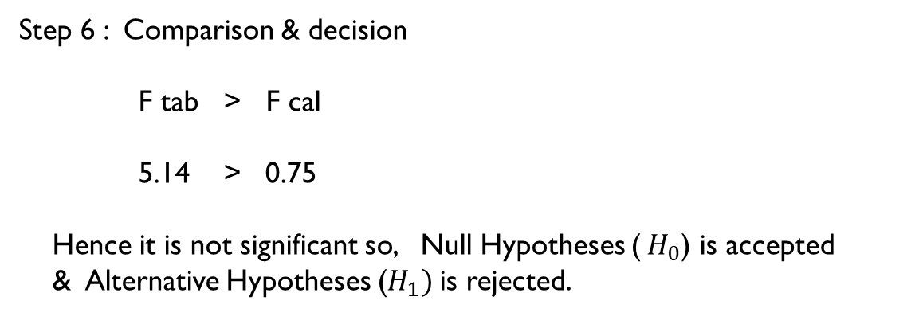
Step 6 : Comparison & decision
F tab > F cal
5.14 > 0.75
Hence it is not significant so, Null Hypotheses ($H_{0}$) is accepted
& Alternative Hypotheses ($H_{1})$is rejected.

Slide 16
CONCLUSION
The outcome of ANOVA is the 'F statistic'. This ratio shows the difference between the within group variance and the between group variance, which ultimately produces a figure which allows a conclusion that the null hypothesis is supported or rejected.

